Slide 1
AI Basics
AI verstehen Teil 1
CREDIT: Roger Grosse Chris Maddison Juhan Bae Silviu Pitis
University of Toronto, Fall 2020
CSC311-Lec1

Slide 2
Kursorga
Ablauf des Kurses:
Zwei Kursschienen pro Tag
Pro Kursschiene: Input, Notebooks, kleine Pause zwischendurch
Für die Notebooks: Pair programming oder alleine
Feedback Bogen am Ende von jedem Tag
Kurs Vibes:
Stellt eure Fragen!
Nutzt GPT, Claude,... zum Lernen
Jargon Catching
Kurssprache
CSC311-Lec1
12 / 55

Slide 3
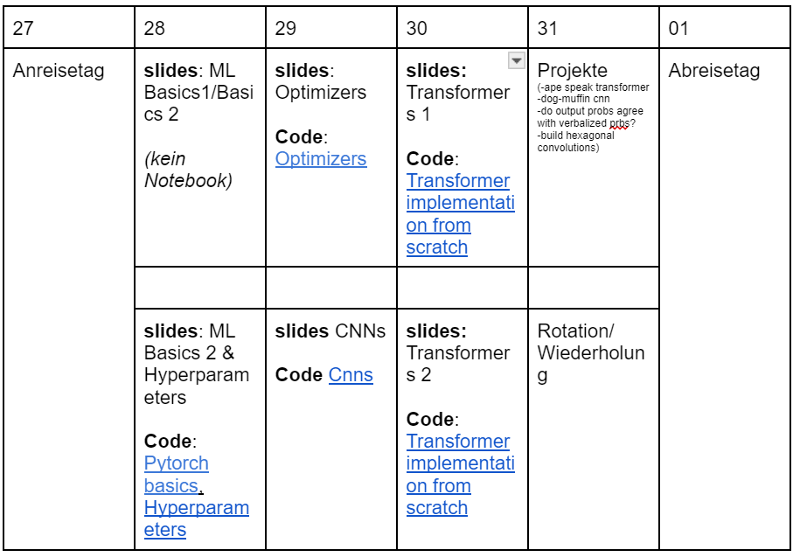
Kursorga
CSC311-Lec1
12 / 55

Slide 4
Kursablauf
Menschen, die an Teil 1 und 2 teilnehmen können ihr Projekt auf der zweiten Hälfte weiterführen.
Materialien gibt es auf GitHub (Link gibt es per Mail). Hat jemand noch kein GitHub?

Slide 5
First things first, wer seid ihr!

Slide 6
What is learning?
”The activity or process of gaining knowledge or skill by studying, practicing, being taught, or experiencing something.”
Merriam Webster dictionary
“A computer program is said to learn from experience E with respect to some class of tasks T and performance measure P, if its performance at tasks in T, as measured by P, improves with experience E.”
Tom Mitchell
CSC311-Lec1

Slide 7
What is machine learning?
For many problems, it’s difficult to program the correct behavior by hand
⁾ recognizing people and objects
⁾ understanding human speech
Machine learning approach: program an algorithm to automatically learn from data, or from experience Why might you want to use a learning algorithm?
CSC311-Lec1
12 / 55

Slide 8
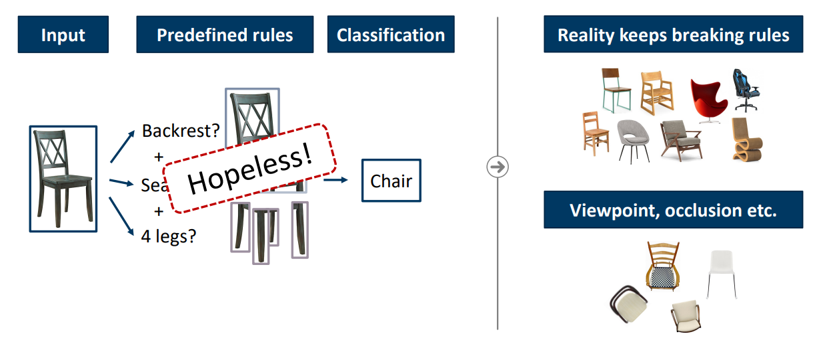
What is machine learning?
Credit: Alexander Ecker @2024
CSC311-Lec1
12 / 55

Slide 9
What is machine learning?
For many problems, it’s difficult to program the correct behavior by hand
⁾ recognizing people and objects
⁾ understanding human speech
Machine learning approach: program an algorithm to automatically learn from data, or from experience Why might you want to use a learning algorithm?
⁾ hard to code up a solution by hand (e.g. vision, speech)
⁾ system needs to adapt to a changing environment (e.g. spam detection)
⁾ want the system to perform better than the human programmers
⁾ privacy/fairness (e.g. ranking search results)
CSC311-Lec1
12 / 55

Slide 10
What is machine learning?
It’s similar to statistics...
⁾ Both fields try to uncover patterns in data
⁾ Both fields draw heavily on calculus, probability, and linear algebra, and share many of the same core algorithms
But it’s not statistics!
⁾ Stats is more concerned with helping scientists and policymakers draw good conclusions; ML is more concerned with building autonomous agents
⁾ Stats puts more emphasis on interpretability and mathematical rigor; ML puts more emphasis on predictive performance, scalability, and autonomy
CSC311-Lec1

Slide 11
Relations to AI
Nowadays, “machine learning” is often brought up with “artificial intelligence” (AI)
AI does not always imply a learning based system
⁾ Symbolic reasoning
⁾ Rule based system
⁾ Tree search
⁾ etc.
Learning based system → learned based on the data → more flexibility, good at solving pattern recognition problems.
CSC311-Lec1

Slide 12
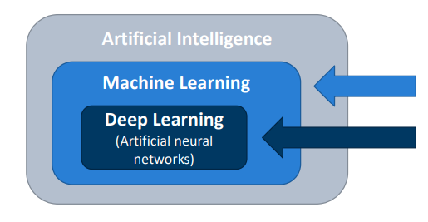
Relations to AI
Credit: Alexander Ecker @2024
CSC311-Lec1

Slide 13
Relations to human learning
Human learning is:
⁾ Very data efficient
⁾ An entire multitasking system (vision, language, motor control, etc.)
⁾ Takes at least a few years :)
For serving specific purposes, machine learning doesn’t have to look like human learning in the end.
It may borrow ideas from biological systems, e.g., neural networks. It may perform better or worse than humans.
CSC311-Lec1

Slide 14
What is machine learning?
Types of machine learning
⁾ Supervised learning: have labeled examples of the correct behavior
⁾ Reinforcement learning: learning system (agent) interacts with the world and learns to maximize a scalar reward signal
⁾ Unsupervised learning: no labeled examples – instead, looking
for “interesting” patterns in the data
CSC311-Lec1

Slide 15
History of machine learning
1957 — Perceptron algorithm (implemented as a circuit!)
1959 — Arthur Samuel wrote a learning-based checkers program that could defeat him
1969 — Minsky and Papert’s book Perceptrons (limitations of linear models)
1980s — Some foundational ideas
⁾ Connectionist psychologists explored neural models of cognition
⁾ 1984 — Leslie Valiant formalized the problem of learning as PAC learning
⁾ 1988 — Backpropagation (re-)discovered by Geoffrey Hinton and
colleagues
⁾ 1988 — Judea Pearl’s book Probabilistic Reasoning in Intelligent Systems introduced Bayesian networks
CSC311-Lec1

Slide 16
History of machine learning
1990s — the “AI Winter”, a time of pessimism and low funding But looking back, the ’90s were also sort of a golden age for ML research
⁾ Markov chain Monte Carlo
⁾ variational inference
⁾ kernels and support vector machines
⁾ boosting
⁾ convolutional networks
⁾ reinforcement learning
2000s — applied AI fields (vision, NLP, etc.) adopted ML 2010s — deep learning
⁾ 2010–2012 — neural nets smashed previous records in speech-to-text and object recognition
⁾ increasing adoption by the tech industry
⁾ 2016 — AlphaGo defeated the human Go champion
⁾ 2018-now — generating photorealistic images and videos
⁾ 2020 — GPT3 language model
now — increasing attention to ethical and societal implications
CSC311-Lec1

Slide 17
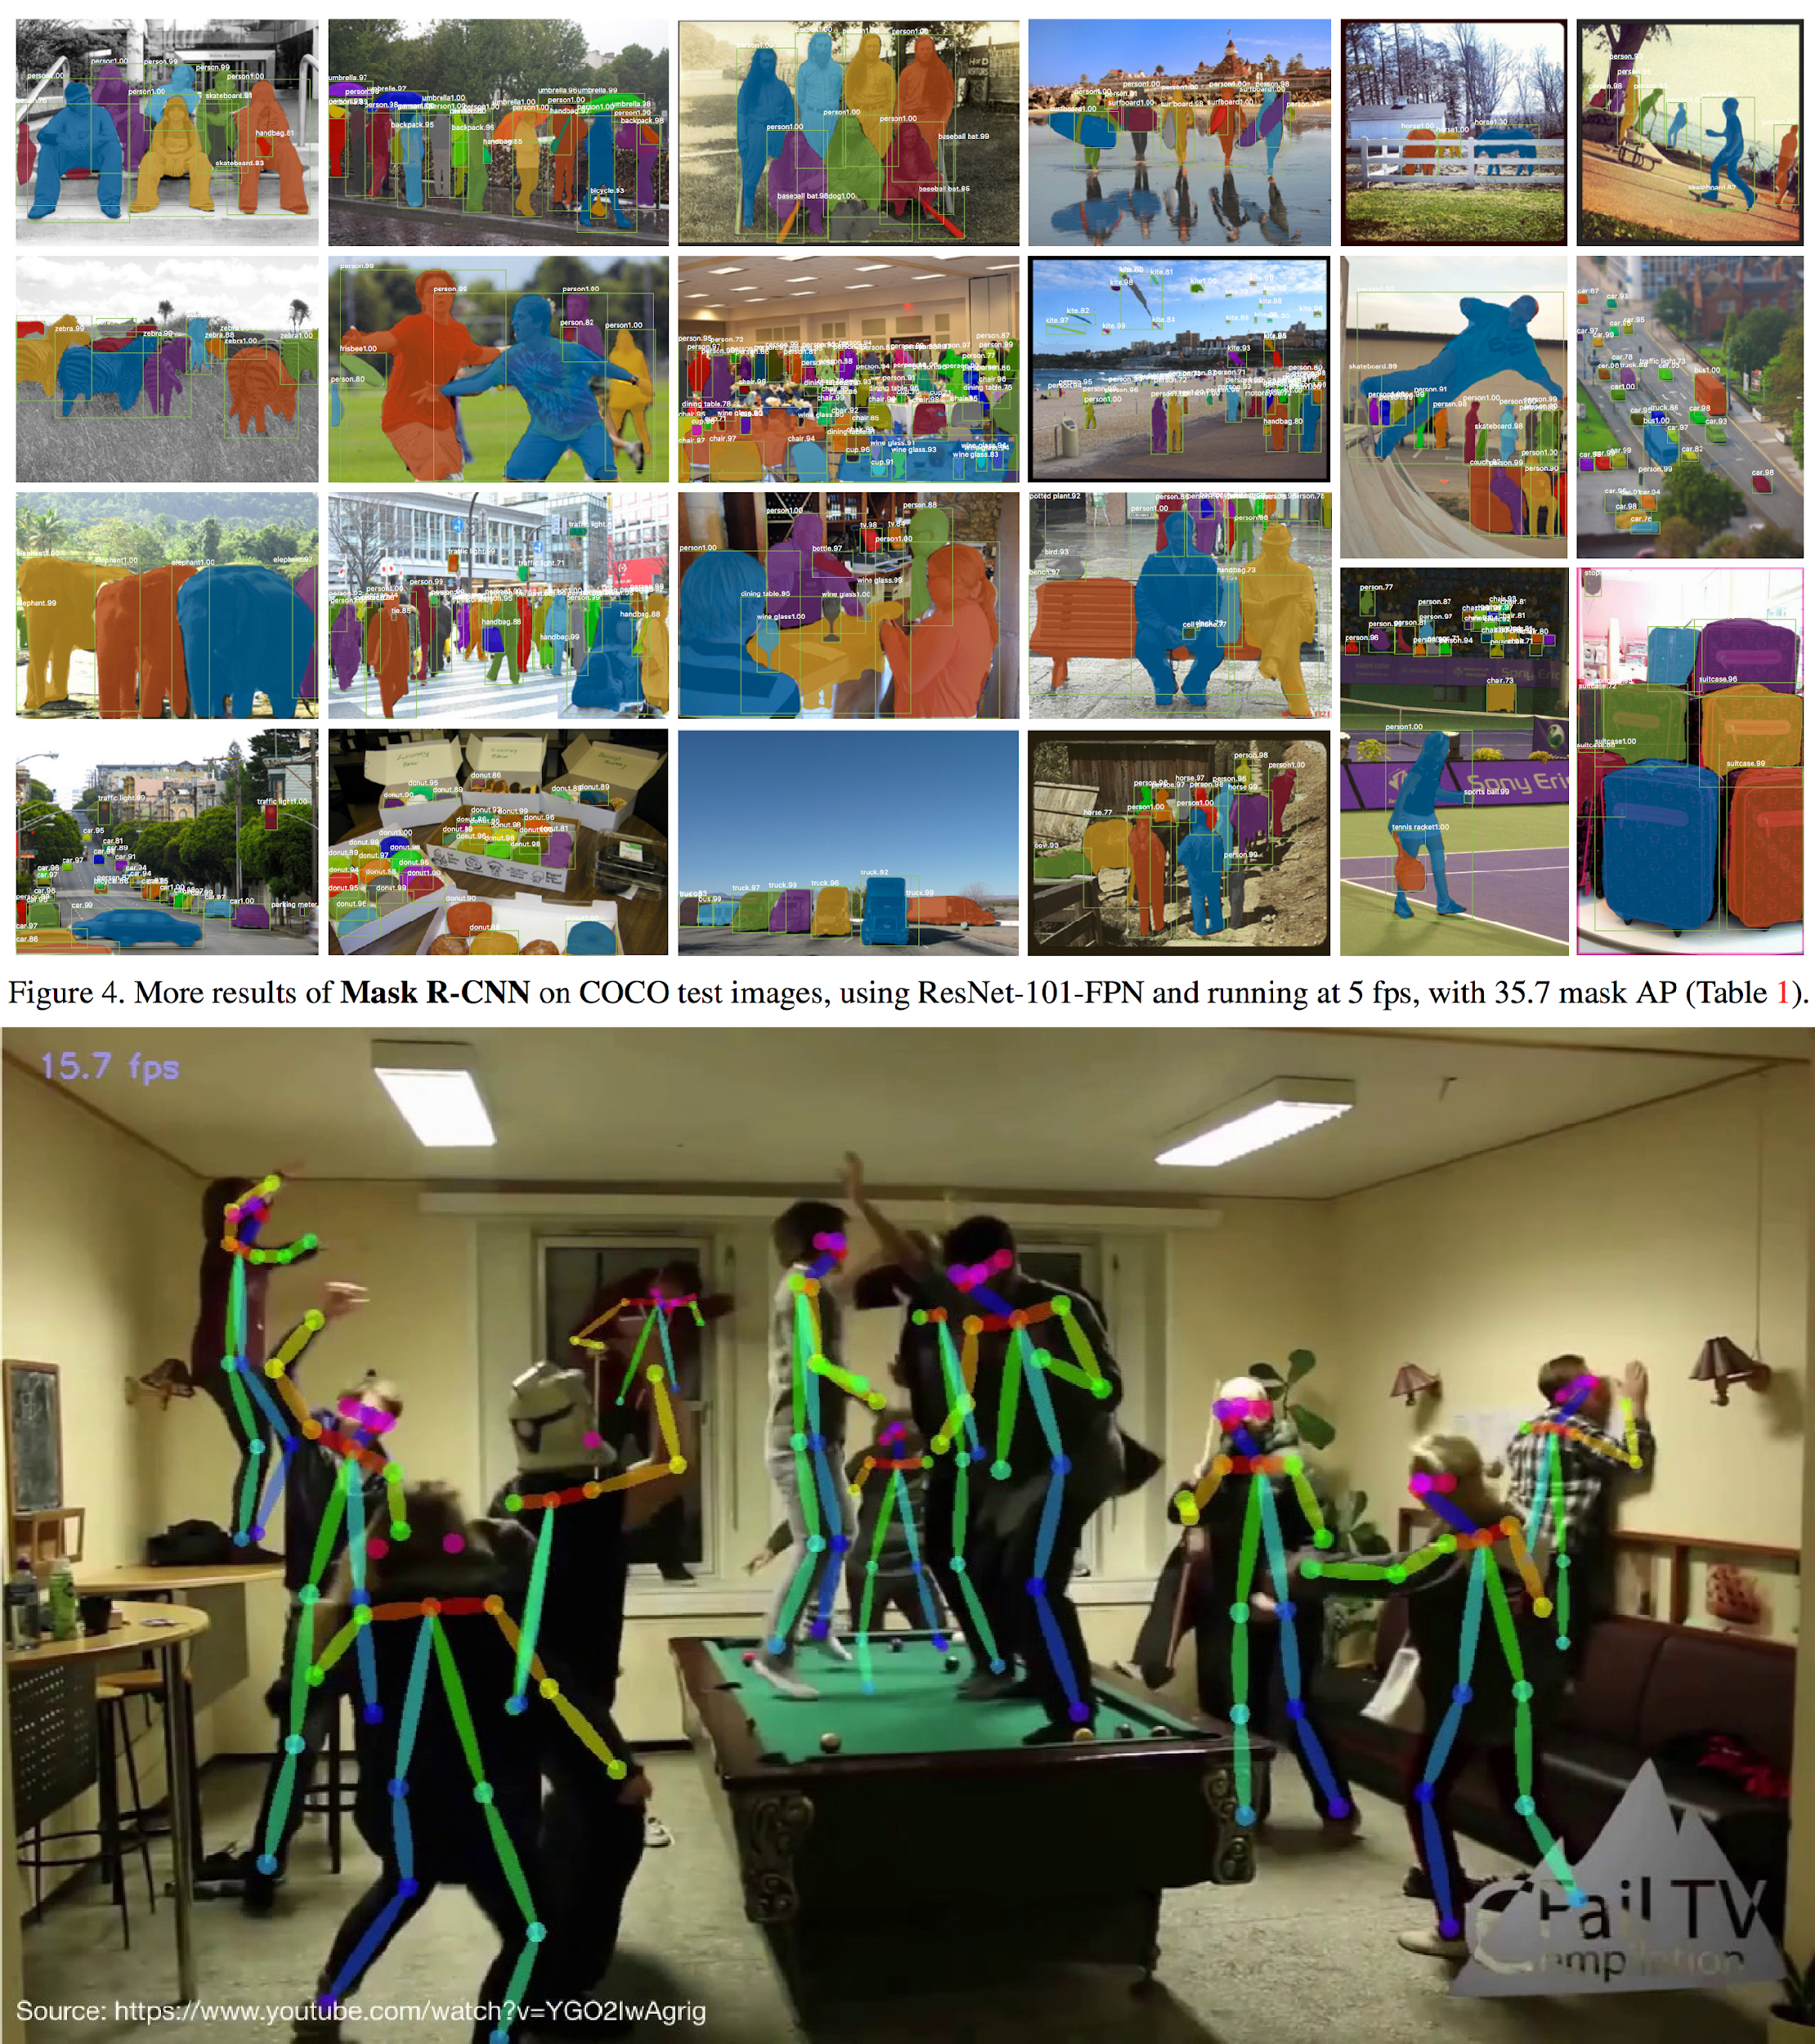
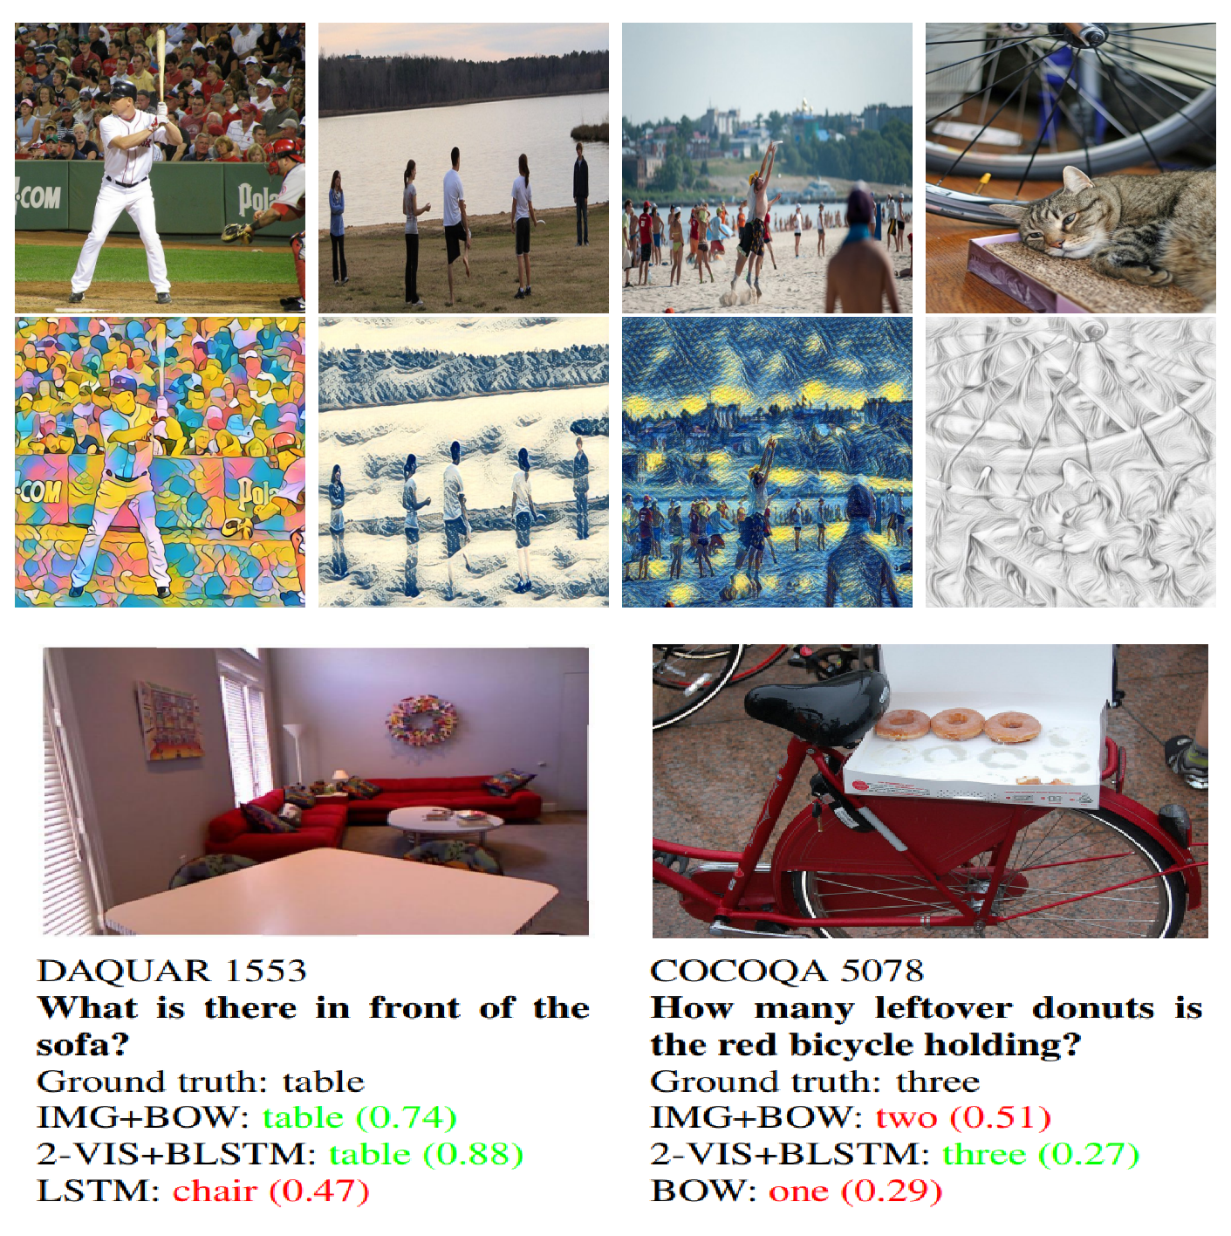
Computer vision: Object detection, semantic segmentation, pose estimation, and almost every other task is done with ML.
Instance segmentation -
Link
CSC311-Lec1

Slide 18

Speech: Speech to text, personal assistants, speaker identification...
CSC311-Lec1

Slide 19
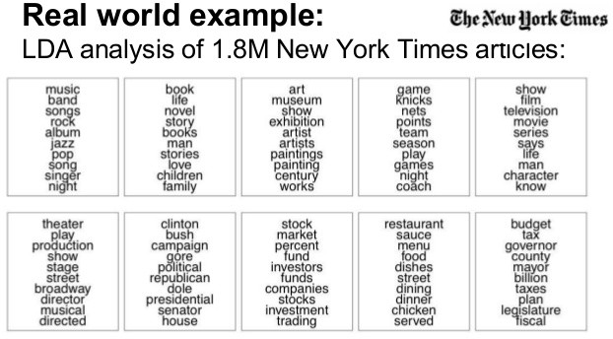
NLP: Machine translation, sentiment analysis, topic modeling, spam filtering.
CSC311-Lec1

Slide 20
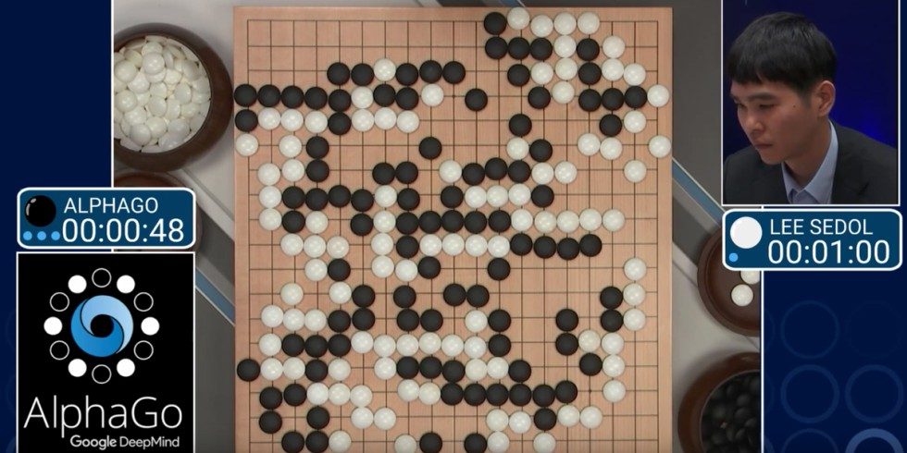
Playing Games
DOTA2 -
Link
CSC311-Lec1

Slide 21

E-commerce & Recommender Systems : Amazon, netflix, ...
CSC311-Lec1

Slide 22

Large Language Models (Chat GPT, Claude,...)
CSC311-Lec1

Slide 23
ML Workflow
ML workflow sketch:
Should I use ML on this problem?
⁾ Is there a pattern to detect?
⁾ Can I solve it analytically?
⁾ Do I have data?
Gather and organize data.
⁾ Preprocessing, cleaning, visualizing.
Establishing a baseline.
Choosing a model, loss, ...
Optimization (could be simple, could be a Phd...).
Hyperparameter search.
Analyze performance & mistakes, and iterate back to step 4 (or 2).
CSC311-Lec1

Slide 24
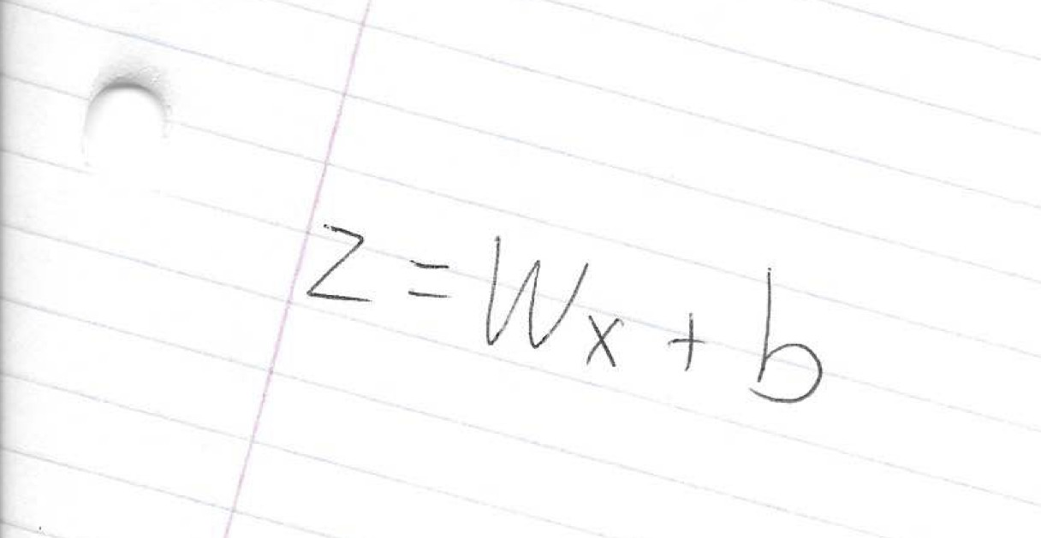
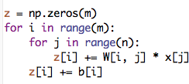
Implementing machine learning systems
You will often need to derive an algorithm (with pencil and paper), and then translate the math into code.
Array processing (NumPy)
⁾ vectorize computations (express them in terms of matrix/vector operations) to exploit hardware efficiency
⁾ This also makes your code cleaner and more readable!
CSC311-Lec1

Slide 25
Implementing machine learning systems
Neural net frameworks: PyTorch, TensorFlow, JAX, etc.
⁾ automatic differentiation
⁾ compiling computation graphs
⁾ libraries of algorithms and network primitives
⁾ support for graphics processing units (GPUs)
CSC311-Lec1

Slide 26
Ein paar ML Anwendungen basics
Neural net frameworks: PyTorch, TensorFlow, JAX, etc.
⁾ automatic differentiation
⁾ compiling computation graphs
⁾ libraries of algorithms and network primitives
⁾ support for graphics processing units (GPUs)
CSC311-Lec1

Slide 27
Implementing machine learning systems
Neural net frameworks: PyTorch, TensorFlow, JAX, etc.
⁾ automatic differentiation
⁾ compiling computation graphs
⁾ libraries of algorithms and network primitives
⁾ support for graphics processing units (GPUs)
CSC311-Lec1

Slide 28
Questions?
?
CSC311-Lec1

